Slide 1
Figure 3
Drought
Wet
Warming
Water availability
Vegetation Cover
Meta Model

Slide 2
When 0.422<VCI<0.55 :
(a)
(b)
-0. 35
(-0.72, 0.02)
Drought
Wet
Drought
(R²=0.39)
Wet
0.34
(0.02, 0.65)
-0.68
(-1.13, -0.23)
ns
0.49
(-2.00, 2.96)
1.07
(0.50, 1.65)
Warming
Water availability
Warming
Water availability
(R²=0. 69)
ns
ns
-0.81
(-5.52, 3.90)
0.47
(-2.27, 3.22)
ns
-0.89
(-25.18, 23.40)
Vegetation Performance
Vegetation Performance
(R²=0.80)

Slide 3
When 0.422<VCI<0.55 :
Figure 4
-0. 35
(-0.72, 0.02)
Drought
(R²=0.39)
Wet
0.34
(0.02, 0.65)
-0.68
(-1.13, -0.23)
ns
0.49
(-2.00, 2.96)
1.07
(0.50, 1.65)
Warming
Water availability
(R²=0. 69)
ns
ns
-0.81
(-5.52, 3.90)
0.47
(-2.27, 3.22)
ns
-0.89
(-25.18, 23.40)
Vegetation Performance
(R²=0.80)

Slide 4
Figure S3
GS precipitation
NGS precipitation
1.00
GS snow cover
0.30
0.99
NGS snow cover
Wet
GS snow depth
42.56
NGS snow depth
7.33
GS snow water
equivalent
NGS snow water equivalent
Test statistic = 1.99, with 4 model degrees of freedom and P-value (Chi-square) = 0.74 (indicating close model-data fit).

Slide 5
Figure S3
GS plant transpiration
NGS plant transpiration
-3.31
-0.07
Drought
GS soil evaporation
1.00
-0.63
NGS soil evaporation
Test statistic = 2.36, with 1 model degrees of freedom and P-value (Chi-square) = 0.13 (again indicating close model-data fit).

Slide 6
Figure S3
GS air temperature
NGS air temperature
1.00
1.47
Warming
GS soil temperature
1. 11
0.47
NGS soil temperature
Test statistic = 1.29, with 1 model degrees of freedom and P-value (Chi-square) = 0.26 (again indicating close model-data fit).

Slide 7
Figure S3
GS air moisture
NGS air moisture
0.95
1.00
Water availability
GS soil moisture
-0.01
-0.01
NGS soil moisture
Test statistic = 0.04, with 1 model degrees of freedom and P-value (Chi-square) = 0.84 (again indicating close model-data fit).

Slide 8
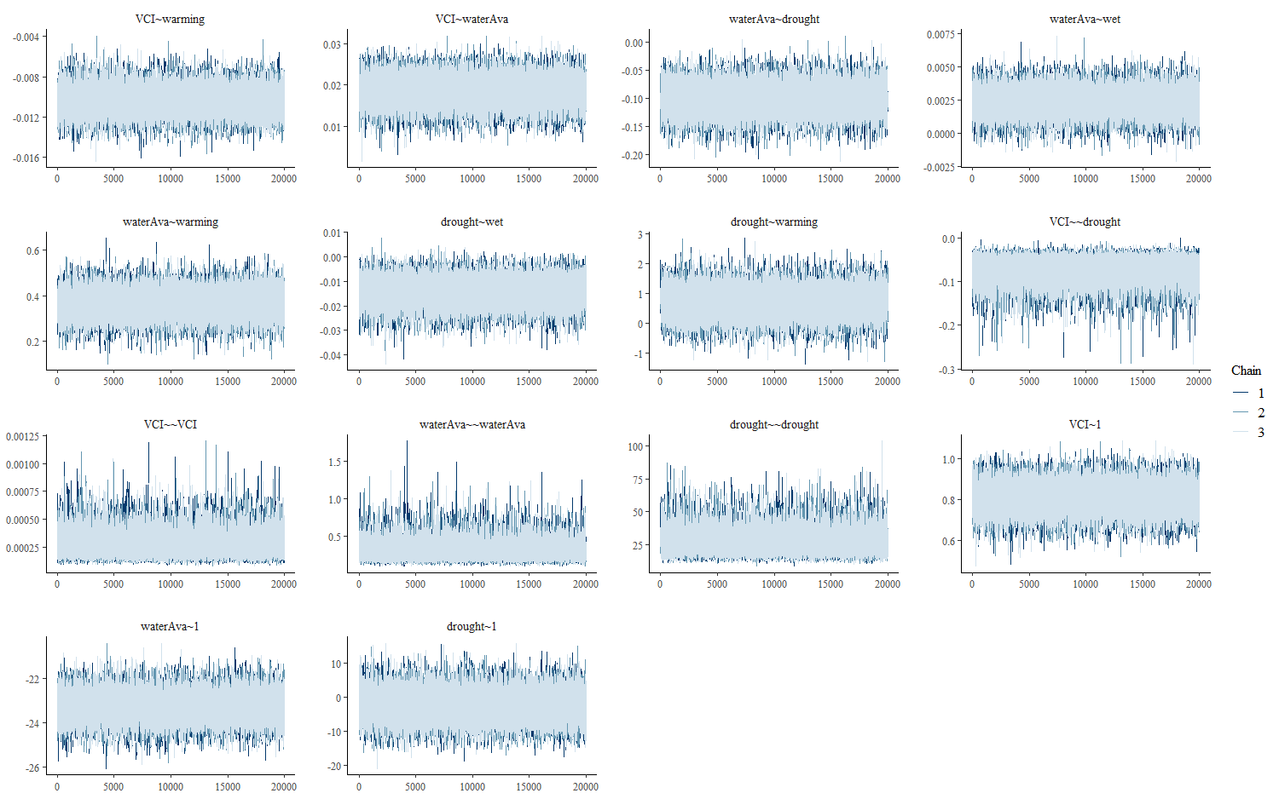
When 0.42<VCI<0.55
Figure S4
SEM模拟效果：很好，卡方p值=0.177，样本量25，自由度11，cfi=0.993，rmsea=0.181，srmr=0.077，gfi=0.999, AIC=32.729，BIC=46.137.
BSEM模拟25000次，前5000次为warmup，共3条chain：很好，BIC=59.00，3条chain重合效果很好。

